Slide 1
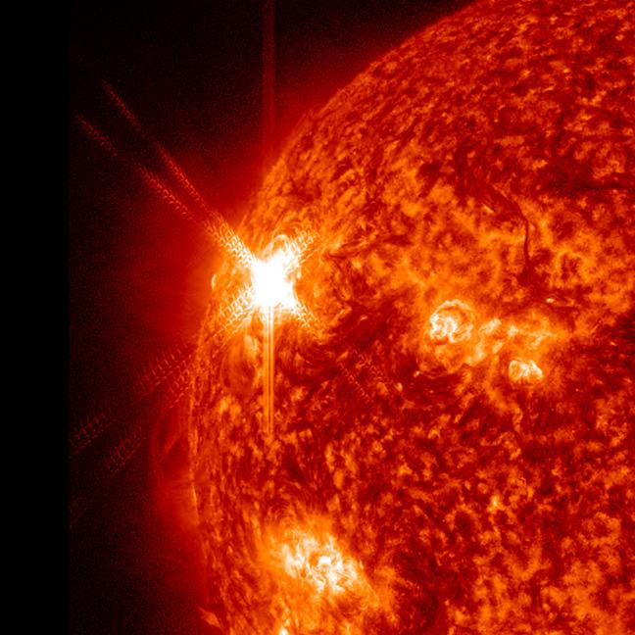
Space Weather: Solar Flares
Dhanesh Krishnarao
NASA GSFC: CCMC/SWRC

Slide 2
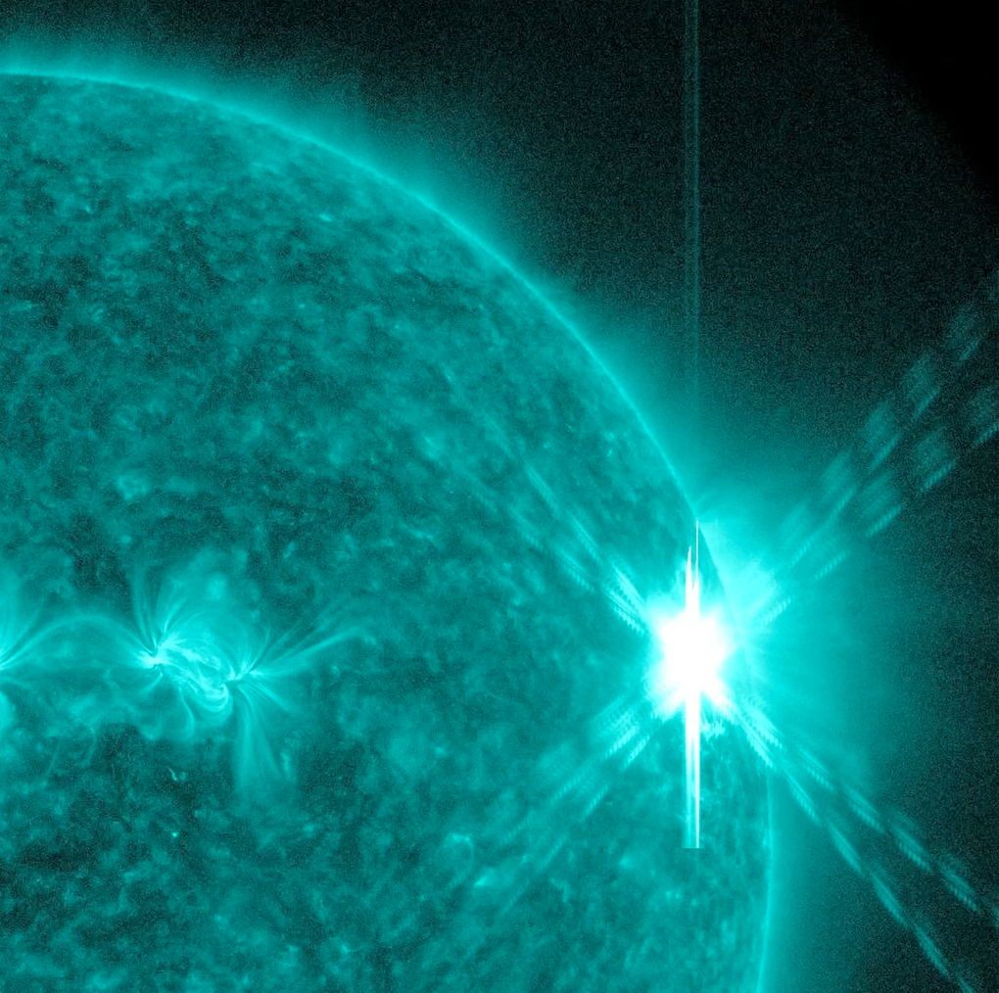
What is a Flare?
A sudden brightening
Conversion of magnetic energy into heat and radiation

Slide 3
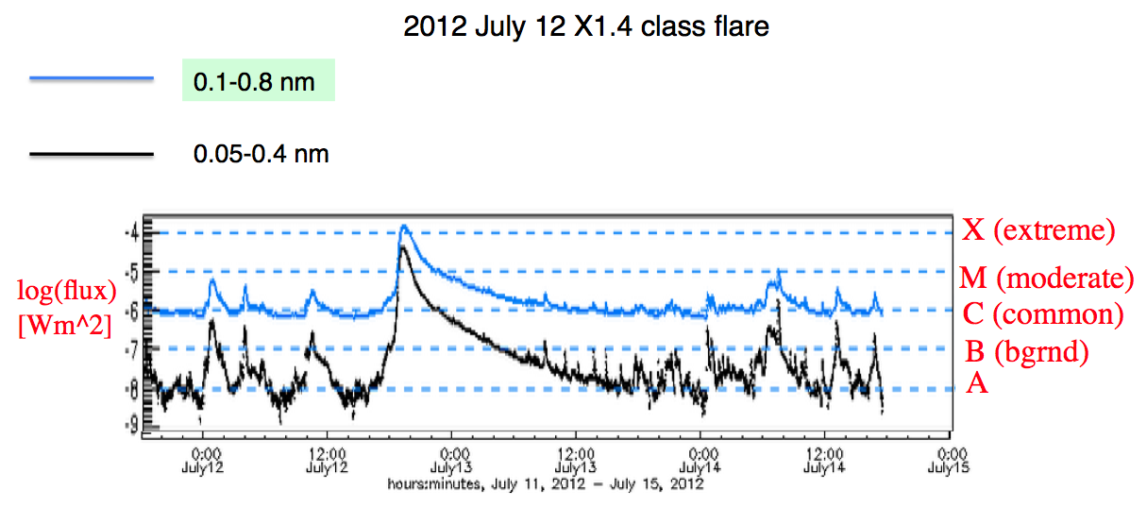
Classification
Based on X-Ray Flux

Slide 4
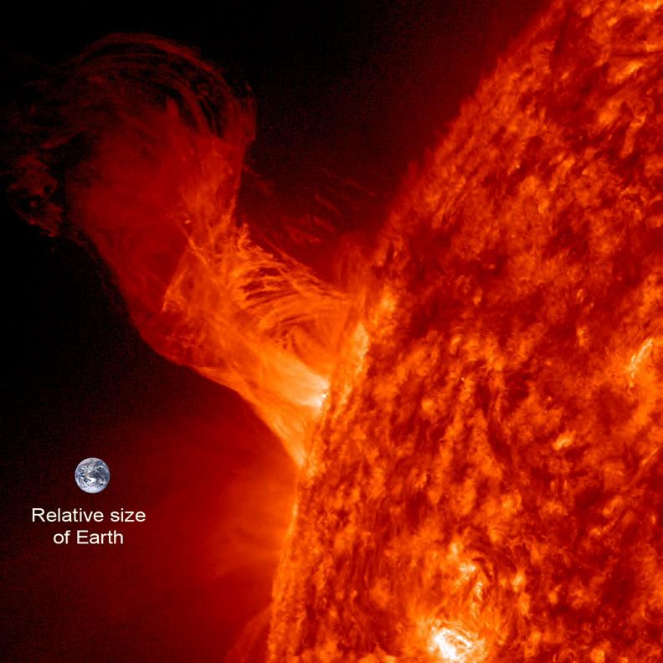
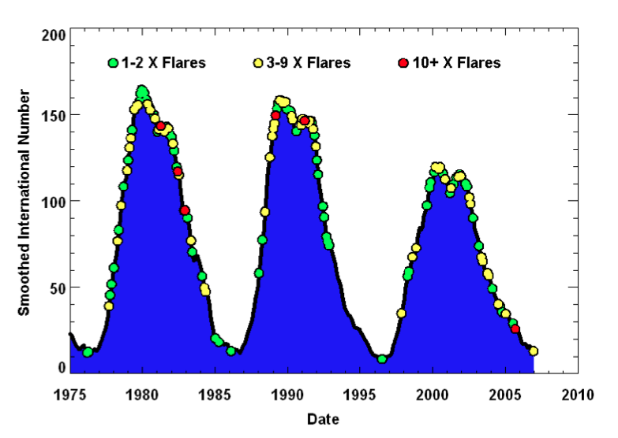
Solar Cycle Relationship
Flares originate from sunspots
More flares occur during Solar Maximum

Slide 5
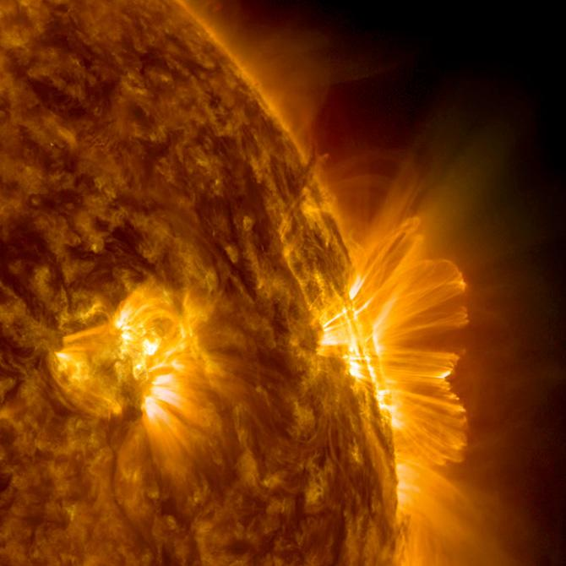
Space Weather Impacts
Radio Blackout!
change structure of ionosphere
lasts minutes to hours long
Affects radio communications and GPS
Tied with SEP events

Slide 6
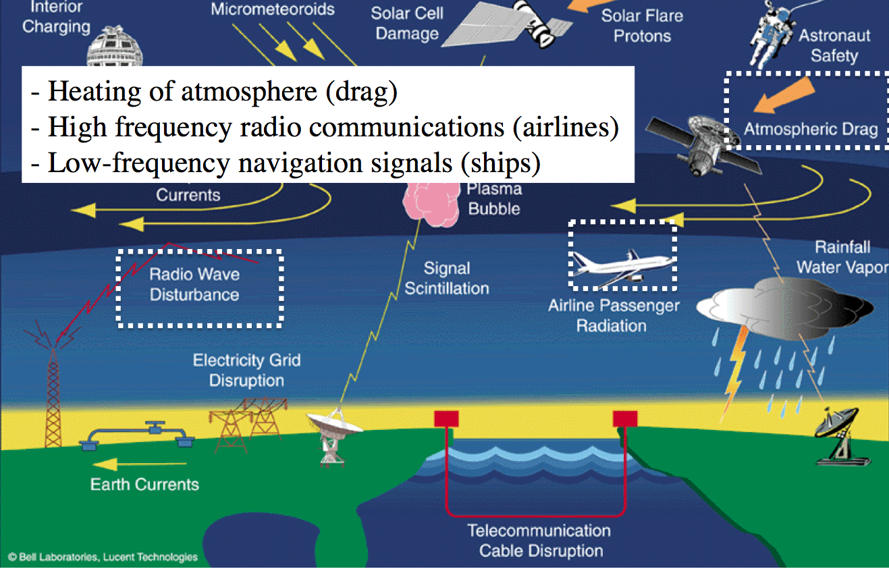
Effects of Radio Blackout !!!

Slide 7
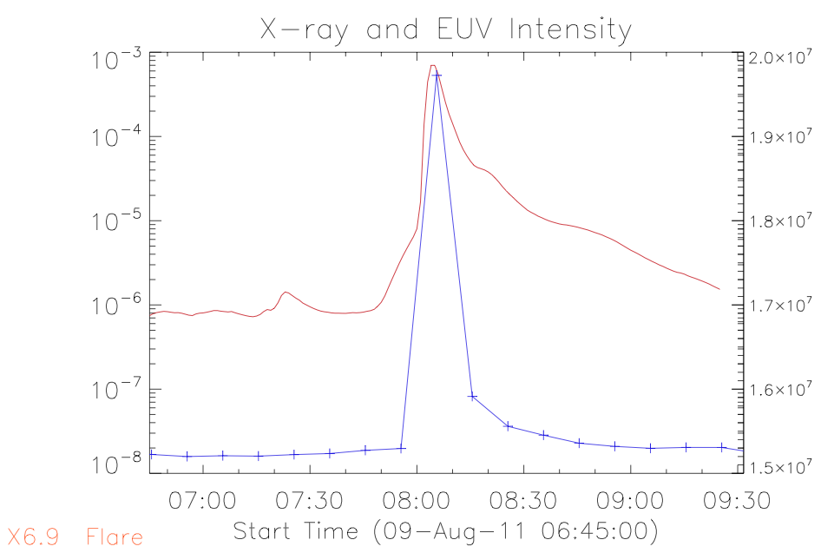

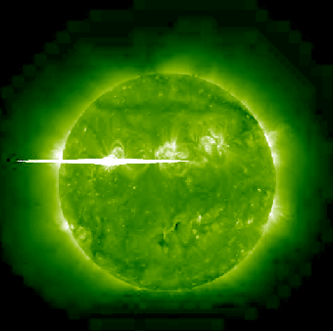
What About Flares That Don’t Face Earth ???
Using STEREO beacon EUVI Data
Compare with GOES X-Ray Data

Slide 8
References
Rebekah’s Introduction to Space Weather http://ccmc.gsfc.nasa.gov/support/SWREDI/Evans-SWREDIBootCamp2013-IntroToSpaceWeatherLecture-FINAL.pdf
Sandro’s Flares and CMEs http://ccmc.gsfc.nasa.gov/support/SWREDI/FlaresCMEs_ATaktakishvilli.pdf

